Slide 1


Ontological Modeling of Vaccine Protection Investigation
Yongqun “Oliver” He, Thomas Todd,
Zuoshuang “Allen” Xiang
Unit for Laboratory Animal Medicine
Department of Microbiology and Immunology
Center for Computational Medicine and Bioinformatics
University of Michigan Medical School
Ann Arbor, MI 48109
Notes:
http://obi-ontology.org/page/Workshop_OBI_Vancouver_2010_Mar#Use_Case_.2B_Issues_Proposals

Slide 2
Vaccine protection investigation
Three processes as described in the OBI JBMS paper:
vaccination: a kind of administering substance in vivo process that realizes some material to be added role, borne by a vaccine (e.g., VacX) as well as a target of material role borne by an organism that also bears a host role (e.g., mouse).
pathogen challenge: a kind of administering substance in vivo process. It realizes a number of roles - a pathogen role and material to be added role borne by the challenge organism (e.g., Influenza Virus), and a target of material role and host role borne by another organism (e.g., mouse).
survival assessment: an assay that measures the survival rate (occurrence of death events) in one or more organisms that are monitored over time.
NOTE: Other assays (e.g., Colony forming unit (CFU) reduction assay) may be needed when a mouse never dies after pathogen challenge.

Slide 3
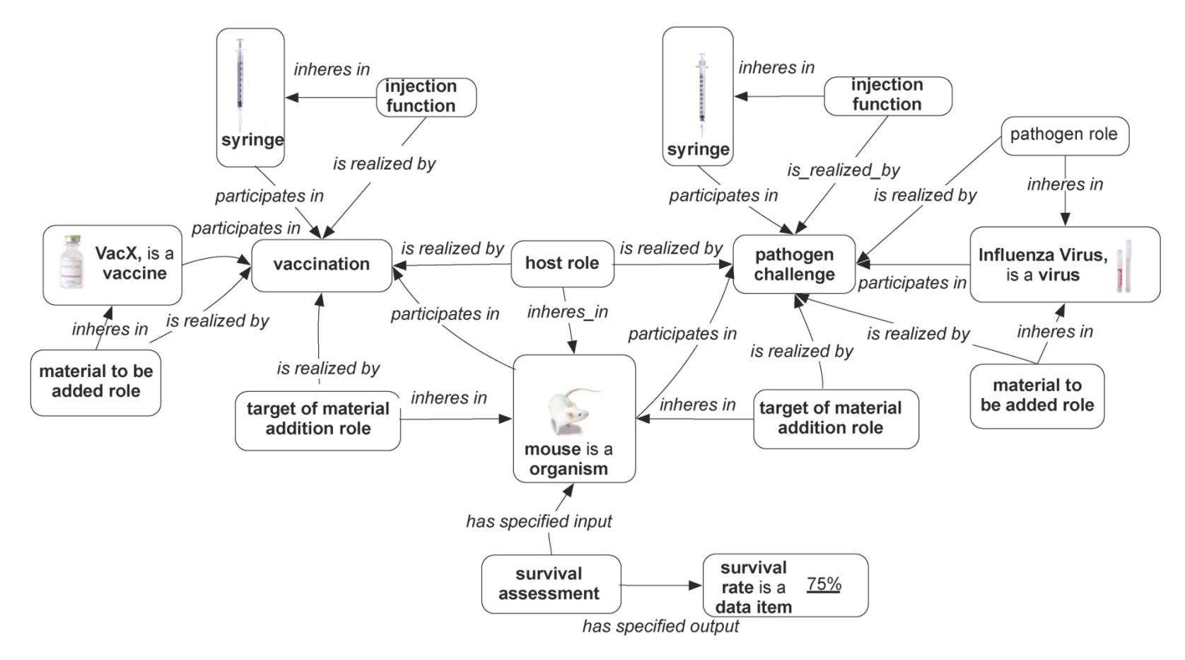
Vaccine protection investigation model in JBMS OBI paper
Ref: OBI JBMS paper, In press

Slide 4
Question:
How to model instance data of vaccine investigation using OBI & other ontology approaches?

Slide 5
Use case study: Brucella vaccine protection investigation
Brucella spp. is intracellular, Gram negative bacteria that cause brucellosis, the most common zoonotic disease in the world, with 0.5 million new human cases yearly.
Wiki: http://en.wikipedia.org/wiki/Brucellosis
No Brucella human vaccine available.
Brucella cattle vaccines: RB51, strain 19, …
Search PubMed “Brucella vaccine”
→ more than 300 publications.

Slide 6
Hypothesis
Some parameters in vaccine protection studies are more important than others in determining the result of the vaccine protection efficacy.

Slide 7
Methods
Ontology modeling of selected parameters in the use case model: OBI, VO, IAO, and other ontologies if needed.
ANOVA (analysis of variance) Statistical analysis
Ontology modeling of the statistical analysis

Slide 8
18 Parameters induced
18 parameters are included.
  Vaccine (VO_0000001),
  vaccine viability (VO_0001139),
  Addition of IL-12 as vaccine adjuvant (VO_0001147),
  Addition of SOD antigen,
  gene deletion,
  animal (host) species,
  animal (host) strain,
  animal (host) sex,
  vaccination route,
  vaccination dose (VO_0000814),
  animal age at vaccination,
  pathogen strain for challenge,
  challenge route,
  challenge dose,
  challenge time (e.g., interval after vaccination),
  colony forming unit (CFU) (VO_0000189 → move to OBI?),
  reduction of colony forming unit (CFU),
  significance of vaccine protection (=vaccine efficiency (VO_0000247)? 3 values: no vaccine protection, significant vaccine protection, enhanced protection).

Slide 9
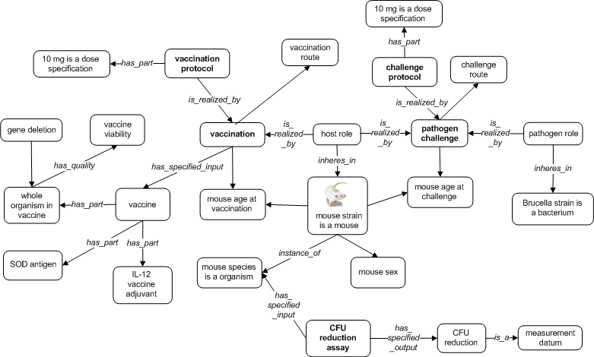
Ontology modeling of parameters
Propose new terms to OBI: mouse strain, mouse species, mouse sex, gene deletion, …
Propose new terms to IAO: dose, time (?), …

Slide 10
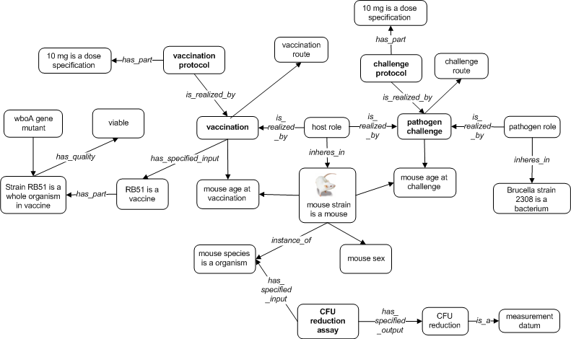
Modeling of Brucella vaccine RB51
Propose

Slide 11
Modeling of vaccination dose
vaccine protocol: has_part some dose specification and is_quality_specification of some volume and quality_of some vaccine
Then a question: is 10 mg an instance of dose specification?
Question: Dose = dose specification?
Doesn't have to be 'is specified‘? Maybe inverse of quality specification of?
Note: May

Slide 12
Modeling of vaccination route
Vaccination route:
E.g., "intraperitoneal injection” (OBI_0000281), which is defined as follows:
  realizes some ‘material to be added role’
  realizes some 'target of material addition role' and (role_of some (peritoneum)
  realizes some (function and 'inheres in' some 'syringe)
Note:
Note: May

Slide 13
Modeling of gene deletion
Gene deletion and insertion are common
Gene deletion forms an organism mutation
Question:
Note: May

Slide 14
Instance Data
~160 instance data from the literature
How many papers?
Investigated the protection levels of several Brucella vaccines at different conditions (with different values of these 18 parameters).

Slide 15
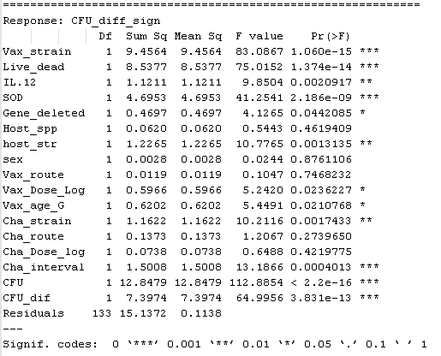
ANOVA Results
5 parameters are not significant (P value < 0.05), 12 yes (P value > 0.05).

Slide 16
Ontology modeling of
ANOVA statistical analysis
As shown in the use case 3 of JBMS paper, ‘hypothesis testing objective’ is available in OBI.
How to generate ANOVA hypothesis using ontology?
How to represent ANOVA input using ontology?
How to represent ANOVA output using ontology?
How to accept or reject a hypothesis?

Slide 17
Ontology Modeling of a Statistical Hypothesis for ANOVA Analysis
Determine two types of variables:
  Dependent (response) variable (e.g., “significance level” in our case)
  Independent variable (other 17 parameters)
  Wiki Reference: http://en.wikipedia.org/wiki/Explanatory_variable#explanatory_variable
One-way ANOVA: a planned comparison
  Compare “Significance level” with others
ANOVA wiki: http://en.wikipedia.org/wiki/Analysis_of_variance

Slide 18
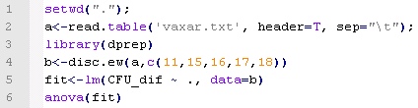
Ontology Modeling of ANOVA Analysis
R code for ANOVA analysis:
disc.ew(): discretization using equal width
lm(): fit linear models
“CFU_dif ~ .”: a formula: CFU_dif (response) vs other variables.
anova(): Compute analysis of variance
Question: How to model them using ontology?

Slide 19
Ontology Modeling of ANOVA Analysis
To replicate the analysis, we may need software, version, formula, parameters, …
We may need software ontology SWO (from James?)
Question: How to model them using ontology?

Slide 20
Ontology Modeling of Input Data for ANOVA Statistical Analysis
Input data are often discretized data from ontology classes or instances
  Ontology classes: mouse strain, mouse species, mouse sex, vaccine viability,
  Ontology instances: age at vaccination, age at challenge, CFU reduction
Discretization methods:
  Category variable
  Quantitative variable:
    Equal interval
    Equal count
    Customization: decided by users
Other issues?

Slide 21
Ontology Modeling of Output Results for ANOVA Statistical Analysis
ANOVA output results are presented by several classes:
  P value – we need this in ontology representation
  Maybe other values (e.g. F value)
May need to represent these in IAO or OBI

Slide 22
Ontology Modeling of P-value
Example: “Vax strain plays a significant role (P < 0.01) in determing the vaccine protection significance”.
Question: How can we model this using ontology?

Slide 23
Discussion
How to model these parameters using OBI, IAO, and VO;
How to model the hypothesis, ANOVA test, and the statistical results using OBI;
How to use OBI/IAO to help statistical data analysis of instance data?
To which scope of statistical analysis we want to model using ontology?
Possible extension of this study to other ontology-based statistical data analysis?

Slide 24
Acknowledgements
NIH-NIAID Grant: R01AI081062
OBI, IAO, PCIRN

